Slide 1
Module 6: Data Link Layer
Introduction to Networks v7.0 (ITN)
Notes:
Cisco Networking Academy Program
Introduction to Networks v7.0 (ITN)
Module 6: Data Link Layer

Slide 2
6.1 Purpose of the Data Link Layer
Notes:
6 - Data Link Layer
6.1 - Purpose of the Data Link Layer

Slide 3
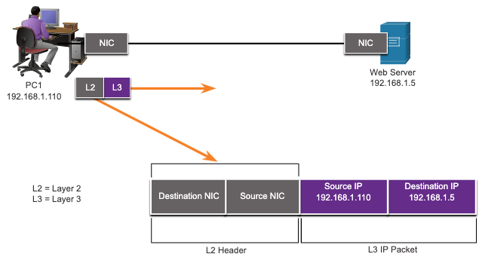
Purpose of the Data Link Layer The Data Link Layer
The Data Link layer is responsible for communications between end-device network interface cards.
It allows upper layer protocols to access the physical layer media and encapsulates Layer 3 packets (IPv4 and IPv6) into Layer 2 Frames.
It also performs error detection and rejects corrupts frames.
Notes:
6 – Data Link Layer
6.1 – Purpose of the Data Link Layer
6.1.1 – The Data Link Layer

Slide 4
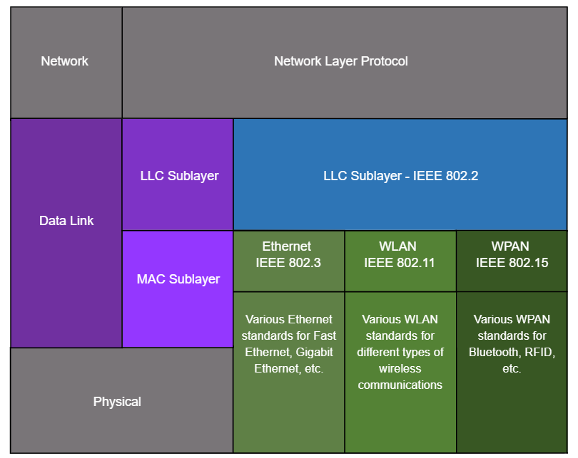
Purpose of the Data Link Layer IEEE 802 LAN/MAN Data Link Sublayers
IEEE 802 LAN/MAN standards are specific to the type of network (Ethernet, WLAN, WPAN, etc).
The Data Link Layer consists of two sublayers. Logical Link Control (LLC) and Media Access Control (MAC).
The LLC sublayer communicates between the networking software at the upper layers and the device hardware at the lower layers.
The MAC sublayer is responsible for data encapsulation and media access control.
Notes:
6 – Data Link Layer
6.1 – Purpose of the Data Link Layer
6.1.2 – IEEE 802 LAN/MAN Data Link Sublayers

Slide 5
Purpose of the Data Link Layer Providing Access to Media
Packets exchanged between nodes may experience numerous data link layers and media transitions.
At each hop along the path, a router performs four basic Layer 2 functions:
Accepts a frame from the network medium.
De-encapsulates the frame to expose the encapsulated packet.
Re-encapsulates the packet into a new frame.
Forwards the new frame on the medium of the next network segment.
Notes:
6 – Data Link Layer
6.1 – Purpose of the Data Link Layer
6.1.3 – Providing Access to Media

Slide 6

Purpose of the Data Link Layer Data Link Layer Standards
Data link layer protocols are defined by engineering organizations:
Institute for Electrical and Electronic Engineers (IEEE).
International Telecommunications Union (ITU).
International Organizations for Standardization (ISO).
American National Standards Institute (ANSI).
Notes:
6 – Data Link Layer
6.1 – Purpose of the Data Link Layer
6.1.4 – Data Link Layer Standards
6.1.5 – Check Your Understanding – Purpose of Data Link Layer

Slide 7
6.2 Topologies
Notes:
6 - Data Link Layer
6.2 - Topologies

Slide 8
Topologies Physical and Logical Topologies
The topology of a network is the arrangement and relationship of the network devices and the interconnections between them.
There are two types of topologies used when describing networks:
Physical topology – shows physical connections and how devices are interconnected.
Logical topology – identifies the virtual connections between devices using device interfaces and IP addressing schemes.
Notes:
6 – Data Link Layer
6.2 – Topologies
6.2.1 – Physical and Logical Topologies

Slide 9
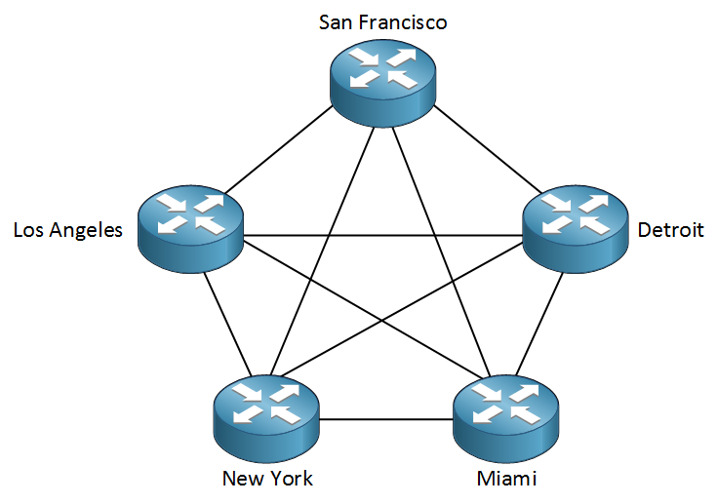
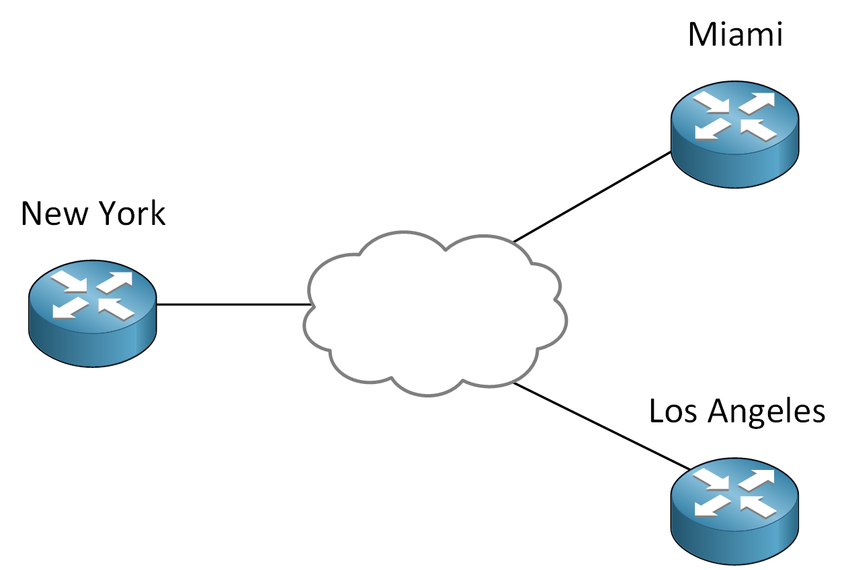
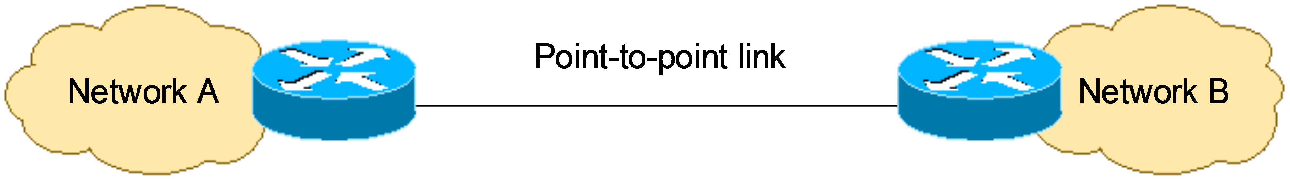
Topologies WAN Topologies
There are three common physical WAN topologies:
Point-to-point – the simplest and most common WAN topology. Consists of a permanent link between two endpoints.
Hub and spoke – similar to a star topology where a central site interconnects branch sites through point-to-point links.
Mesh – provides high availability but requires every end system to be connected to every other end system.
Notes:
6 – Data Link Layer
6.2 – Topologies
6.2.2 – WAN Topologies

Slide 10
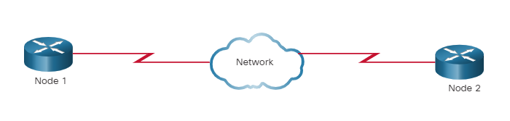
Topologies Point-to-Point WAN Topology
Physical point-to-point topologies directly connect two nodes.
The nodes may not share the media with other hosts.
Because all frames on the media can only travel to or from the two nodes, Point-to-Point WAN protocols can be very simple.
Notes:
6 – Data Link Layer
6.2 – Topologies
6.2.3– Point-to-Point WAN Topology

Slide 11
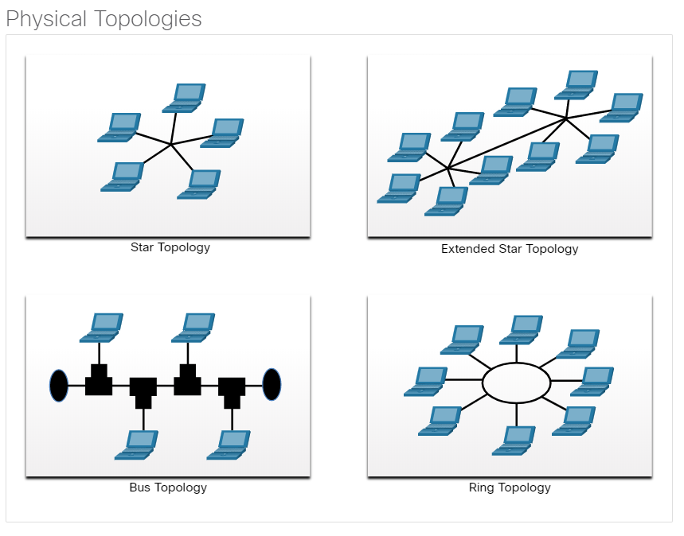
Topologies LAN Topologies
End devices on LANs are typically interconnected using a star or extended star topology. Star and extended star topologies are easy to install, very scalable and easy to troubleshoot.
Early Ethernet and Legacy Token Ring technologies provide two additional topologies:
Bus – All end systems chained together and terminated on each end.
Ring – Each end system is connected to its respective neighbors to form a ring.
Notes:
6 – Data Link Layer
6.2 – Topologies
6.2.4 – LAN Topologies

Slide 12
Topologies Half and Full Duplex Communication
Half-duplex communication
Only allows one device to send or receive at a time on a shared medium.
Used on WLANs and legacy bus topologies with Ethernet hubs.
Full-duplex communication
Allows both devices to simultaneously transmit and receive on a shared medium.
Ethernet switches operate in full-duplex mode.
Notes:
6 – Data Link Layer
6.2 – Topologies
6.2.5 – Half and Full Duplex Communication

Slide 13
Topologies Access Control Methods
Contention-based access
All nodes operating in half-duplex, competing for use of the medium. Examples are:
Carrier sense multiple access with collision detection (CSMA/CD) as used on legacy bus-topology Ethernet.
Carrier sense multiple access with collision avoidance (CSMA/CA) as used on Wireless LANs.
Controlled access
Deterministic access where each node has its own time on the medium.
Used on legacy networks such as Token Ring and ARCNET.
Notes:
6 – Data Link Layer
6.2 – Topologies
6.2.6 – Access Control Methods

Slide 14
Topologies Contention-Based Access – CSMA/CD
CSMA/CD
Used by legacy Ethernet LANs.
Operates in half-duplex mode where only one device sends or receives at a time.
Uses a collision detection process to govern when a device can send and what happens if multiple devices send at the same time.
CSMA/CD collision detection process:
Devices transmitting simultaneously will result in a signal collision on the shared media.
Devices detect the collision.
Devices wait a random period of time and retransmit data.
Notes:
6 – Data Link Layer
6.2 – Topologies
6.2.7 – Contention-Based Access – CSMA/CD

Slide 15
Topologies Contention-Based Access – CSMA/CA
CSMA/CA
Used by IEEE 802.11 WLANs.
Operates in half-duplex mode where only one device sends or receives at a time.
Uses a collision avoidance process to govern when a device can send and what happens if multiple devices send at the same time.
CSMA/CA collision avoidance process:
RTS/CTS (Request to Send / Clear to Send) works as a preventive mechanism to reduce the likelihood of collisions in a wireless network.
When a device wants to send data, it first sends a short RTS message requesting permission to use the medium.
The receiving device replies with a CTS message, informing all nearby nodes that the medium is reserved for communication.
Other stations that receive the CTS message pause their transmissions for the specified duration, greatly reducing the chance of collision during data transfer.
Notes:
6 – Data Link Layer
6.2 – Topologies
6.2.8 – Contention-Based Access – CSMA/CA
6.2.9 – Check Your Understanding - Topologies

Slide 16
6.3 Data Link Frame
Notes:
6 - Data Link Layer
6.3 - Data Link Frame

Slide 17
Data Link Frame The Frame
Data is encapsulated by the data link layer with a header and a trailer to form a frame.
A data link frame has three parts:
Header
Data
Trailer
The fields of the header and trailer vary according to data link layer protocol.
The amount of control information carried with in the frame varies according to access control information and logical topology.
Notes:
6 – Data Link Layer
6.3 – Data Link Frame
6.3.1 – The Frame

Slide 18
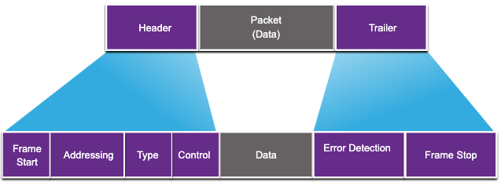
Data Link Frame Frame Fields
Field | Description
Frame Start and Stop | Identifies beginning and end of frame
Addressing | Indicates source and destination nodes
Type | Identifies encapsulated Layer 3 protocol
Control | Identifies flow control services
Data | Contains the frame payload
Error Detection | Used for determine transmission errors
Notes:
6 – Data Link Layer
6.3 – Data Link Frame
6.3.2 – Frame Fields

Slide 19
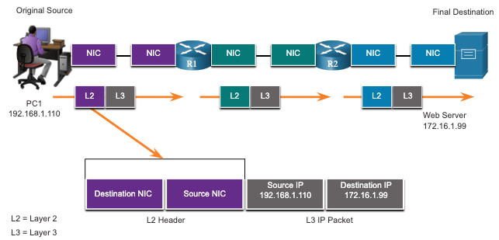
Data Link Frame Layer 2 Addresses
Also referred to as a physical address.
Contained in the frame header.
Used only for local delivery of a frame on the link.
Updated by each device that forwards the frame.
Notes:
6 – Data Link Layer
6.3 – Data Link Frame
6.3.3 – Layer 2 Address

Slide 20
Data Link Frame LAN and WAN Frames
The logical topology and physical media determine the data link protocol used:
Ethernet
802.11 Wireless
Point-to-Point (PPP)
High-Level Data Link Control (HDLC)
Frame-Relay
Each protocol performs media access control for specified logical topologies.
Notes:
6 – Data Link Layer
6.3 – Data Link Frame
6.3.4 – LAN and WAN Frames
6.3.5 – Check Your Understanding – Data Link Frame

Slide 21
Module 7: Ethernet Switching
Introduction to Networks v7.0 (ITN)
Notes:
Cisco Networking Academy Program
Introduction to Networks v7.0 (ITN)
Module 7: Ethernet Switching

Slide 22
7.1 Ethernet Frames
Notes:
7 - Ethernet Switching
7.1 Ethernet frames

Slide 23
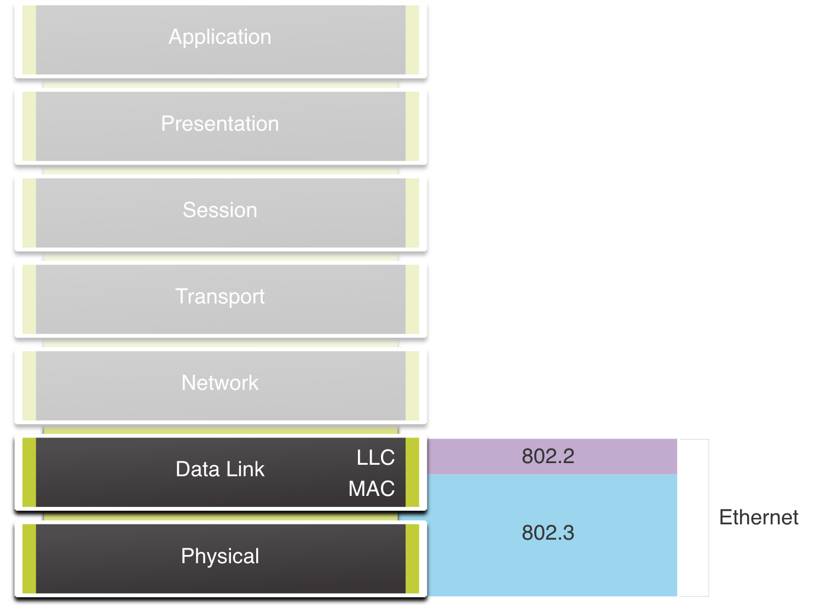
Ethernet Frames Ethernet Encapsulation
Ethernet operates in the data link layer and the physical layer.
It is a family of networking technologies defined in the IEEE 802.2 and 802.3 standards.
Notes:
7 – Ethernet Switching
7.1 – Ethernet Frames
7.1.1 – Ethernet Encapsulation

Slide 24
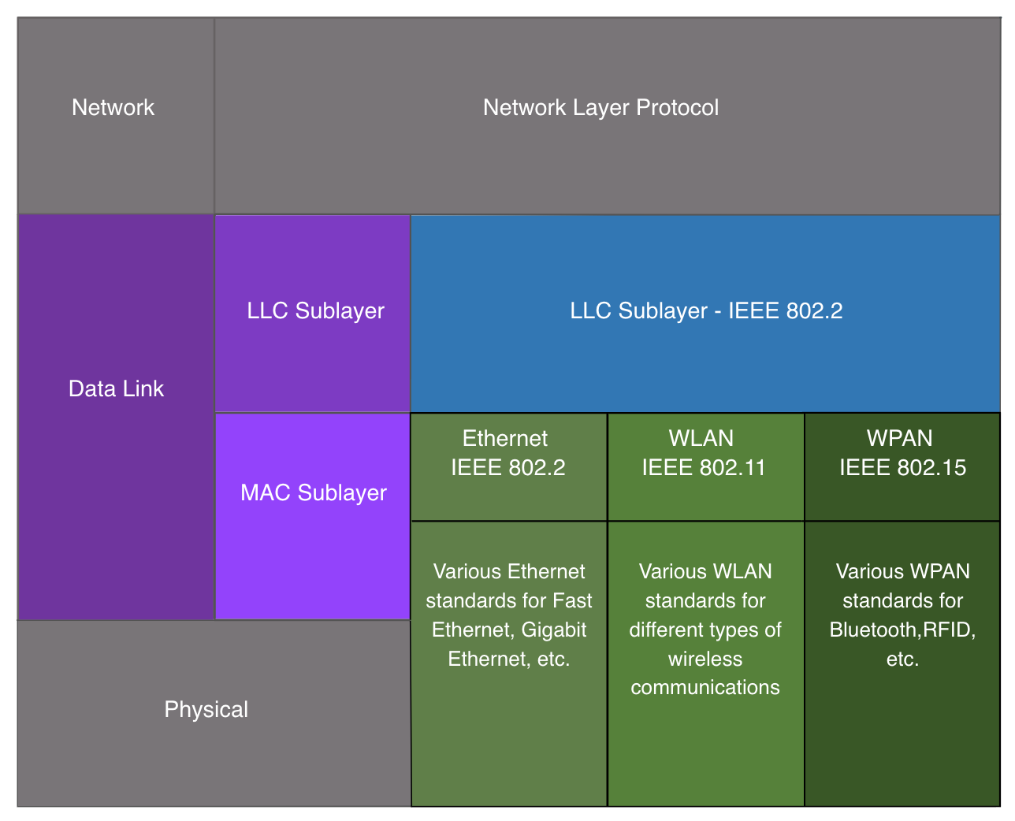
Ethernet Frames Data Link Sublayers
The 802 LAN/MAN standards, including Ethernet, use two separate sublayers of the data link layer to operate:
LLC Sublayer: (IEEE 802.2) Places information in the frame to identify which network layer protocol is used for the frame.
MAC Sublayer: (IEEE 802.3, 802.11, or 802.15) Responsible for data encapsulation and media access control, and provides data link layer addressing.
IEEE 802.1 – Higher Layer LAN Protocols, Bridging & Management IEEE 802.2 – Logical Link Control (LLC) IEEE 802.3 – Ethernet (CSMA/CD IEEE 802.5 – Token Ring (MAC) IEEE 802.6 – Metropolitan Area Networks (DQDB) IEEE 802.10 – LAN/MAN Security IEEE 802.11 – Wireless LAN (Wi‑Fi), zahŕňa 802.11a/b/g/n/ac/ad atď. IEEE 802.15 – Wireless Personal Area Networks (WPAN) — napr. Bluetooth, Zigbee IEEE 802.16 – Broadband Wireless Access (WiMAX) IEEE 802.17 – Resilient Packet Ring (RPR) (MAC pre MAN/LAN) IEEE 802.20 – Mobile Broadband Wireless Access IEEE 802.21 – Media Independent Handover (MIH) IEEE 802.22 – Cognitive Wireless RAN (WRAN) – MAC + PHY pre kognitívne siete využívajúce TV pásma
Notes:
7 – Ethernet Switching
7.1 – Ethernet Frames
7.1.2 - Data Link Sublayers

Slide 25
Ethernet Frames MAC Sublayer
The MAC sublayer is responsible for data encapsulation and accessing the media.
Data Encapsulation
IEEE 802.3 data encapsulation includes the following:
Ethernet frame - This is the internal structure of the Ethernet frame.
Ethernet Addressing - The Ethernet frame includes both a source and destination MAC address to deliver the Ethernet frame from Ethernet NIC to Ethernet NIC on the same LAN.
Ethernet Error detection - The Ethernet frame includes a frame check sequence (FCS) trailer used for error detection.
Notes:
7 – Ethernet Switching
7.1 – Ethernet Frames
7.1.3 – MAC Sublayer

Slide 26
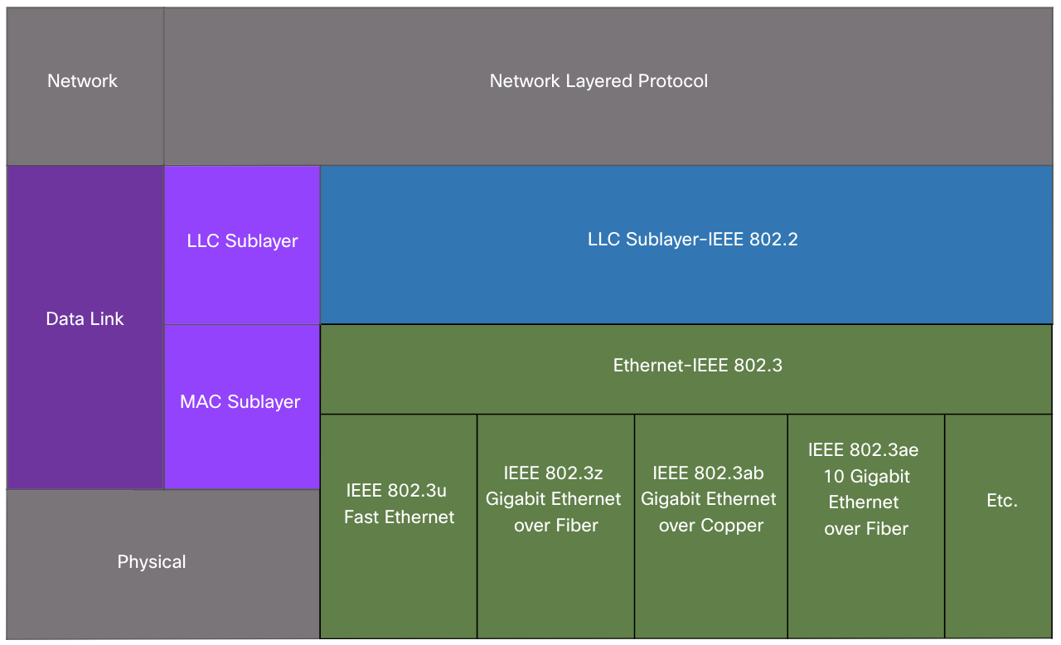
Ethernet Frames MAC Sublayer
Media Access
The IEEE 802.3 MAC sublayer includes the specifications for different Ethernet communications standards over various types of media including copper and fiber.
Legacy Ethernet using a bus topology or hubs, is a shared, half-duplex medium. Ethernet over a half-duplex medium uses a contention-based access method, carrier sense multiple access/collision detection (CSMA/CD).
Ethernet LANs of today use switches that operate in full-duplex. Full-duplex communications with Ethernet switches do not require access control through CSMA/CD.
Notes:
7 – Ethernet Switching
7.1 – Ethernet Frames
7.1.3 – MAC Sublayer

Slide 27
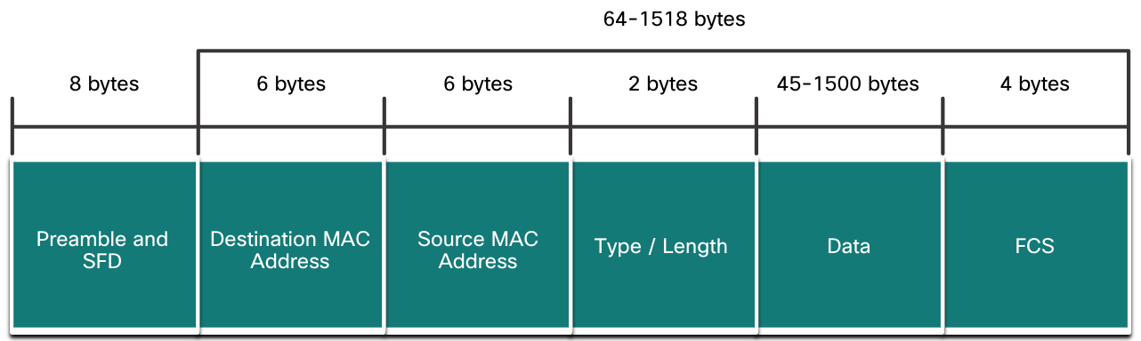
Ethernet Frames Ethernet Frame Fields
The minimum Ethernet frame size is 64 bytes and the maximum is 1518 bytes. The preamble field is not included when describing the size of the frame.
Any frame less than 64 bytes in length is considered a “collision fragment” or “runt frame” and is automatically discarded. Frames with more than 1500 bytes of data are considered “jumbo” or “baby giant frames”.
If the size of a transmitted frame is less than the minimum, or greater than the maximum, the receiving device drops the frame. Dropped frames are likely to be the result of collisions or other unwanted signals. They are considered invalid. Jumbo frames are usually supported by most Fast Ethernet and Gigabit Ethernet switches and NICs.
46-1500 bytes
12 bytes
interframe gap
start frame delimiter
8+64+12 = 84 bytes on the wire...
Notes:
7 – Ethernet Switching
7.1 – Ethernet Frames
7.1.4 – Ethernet Frame Fields
7.1.5 – Check Your Understanding – Ethernet Switching
Zdroj: layer1 - Minimum ethernet frame is 64 bytes, Why the payload must be padded to at least 46 bytes - Network Engineering Stack Exchange

Slide 28
7.2 Ethernet MAC Address
Notes:
7 - Ethernet Switching
7.2 - Ethernet MAC Address

Slide 29
Ethernet MAC Addresses MAC Address and Hexadecimal
An Ethernet MAC address consists of a 48-bit binary value, expressed using 12 hexadecimal values.
Given that 8 bits (one byte) is a common binary grouping, binary 00000000 to 11111111 can be represented in hexadecimal as the range 00 to FF,
When using hexadecimal, leading zeroes are always displayed to complete the 8-bit representation. For example, the binary value 0000 1010 is represented in hexadecimal as 0A.
Hexadecimal numbers are often represented by the value preceded by 0x (e.g., 0x73) to distinguish between decimal and hexadecimal values in documentation.
Hexadecimal may also be represented by a subscript 16, or the hex number followed by an H (e.g., 73H).
Notes:
7 – Ethernet Switching
7.2 – Ethernet MAC Address
7.2.1 – MAC Address and Hexadecimal

Slide 30
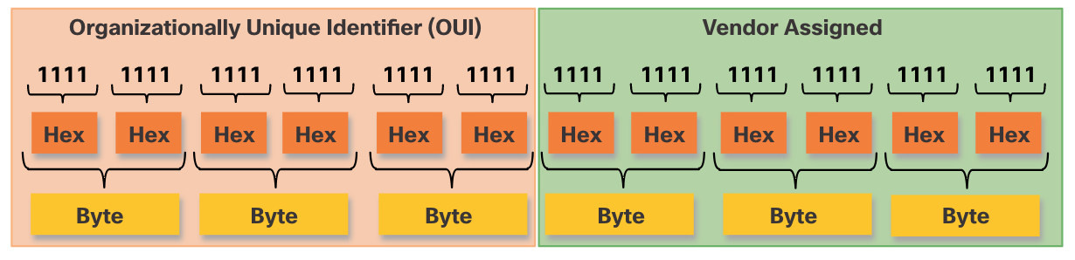
Ethernet MAC Addresses Ethernet MAC Address
In an Ethernet LAN, every network device is connected to the same, shared media. MAC addressing provides a method for device identification at the data link layer of the OSI model.
An Ethernet MAC address is a 48-bit address expressed using 12 hexadecimal digits. Because a byte equals 8 bits, we can also say that a MAC address is 6 bytes in length.
All MAC addresses must be unique to the Ethernet device or Ethernet interface. To ensure this, all vendors that sell Ethernet devices must register with the IEEE to obtain a unique 6 hexadecimal (i.e., 24-bit or 3-byte) code called the organizationally unique identifier (OUI).
An Ethernet MAC address consists of a 6 hexadecimal vendor OUI code followed by a 6 hexadecimal vendor-assigned value.
Notes:
7 – Ethernet Switching
7.2 – Ethernet MAC Address
7.2.2 – Ethernet MAC Address

Slide 31
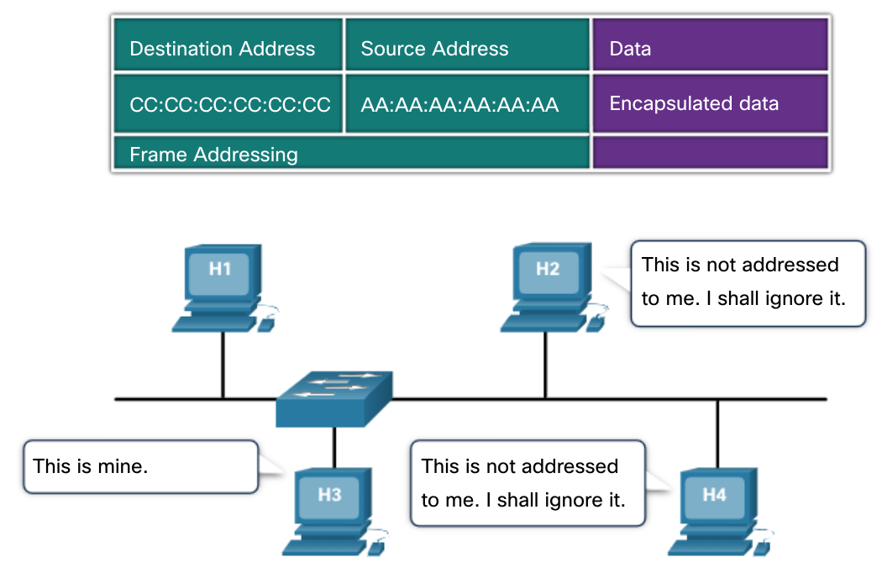
Ethernet MAC Addresses Frame Processing
When a device is forwarding a message to an Ethernet network, the Ethernet header include a Destination MAC address and a Source MAC address.
When a NIC receives an Ethernet frame, it examines the destination MAC address to see if it matches the physical MAC address that is stored in RAM. If there is no match, the device discards the frame. If there is a match, it passes the frame up the OSI layers, where the de-encapsulation process takes place.
Note: Ethernet NICs will also accept frames if the destination MAC address is a broadcast or a multicast group of which the host is a member.
Any device that is the source or destination of an Ethernet frame, will have an Ethernet NIC and therefore, a MAC address. This includes workstations, servers, printers, mobile devices, and routers.
Notes:
7 – Ethernet Switching
7.2 – Ethernet MAC Address
7.2.3 – Frame Processing

Slide 32
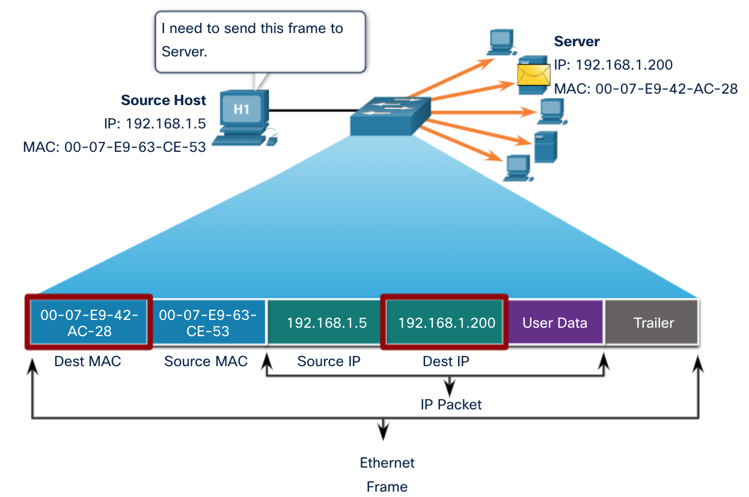
Ethernet MAC Addresses Unicast MAC Address
In Ethernet, different MAC addresses are used for Layer 2 unicast, broadcast, and multicast communications.
A unicast MAC address is the unique address that is used when a frame is sent from a single transmitting device to a single destination device.
The process that a source host uses to determine the destination MAC address associated with an IPv4 address is known as Address Resolution Protocol (ARP). The process that a source host uses to determine the destination MAC address associated with an IPv6 address is known as Neighbor Discovery (ND).
Note: The source MAC address must always be a unicast.
Notes:
7 – Ethernet Switching
7.2 – Ethernet MAC Address
7.2.4 – Unicast MAC Address

Slide 33
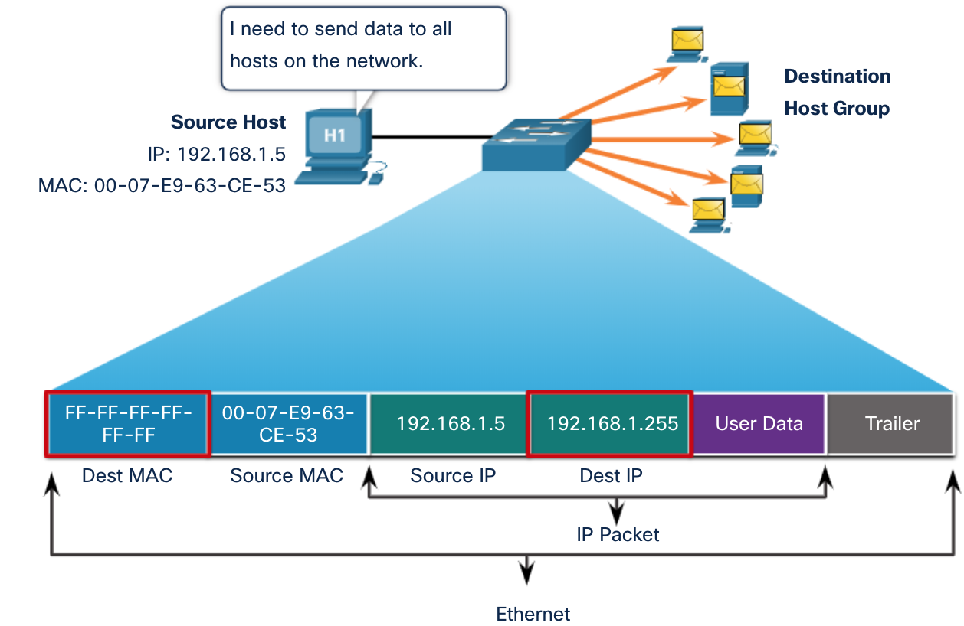
Ethernet MAC Addresses Broadcast MAC Address
An Ethernet broadcast frame is received and processed by every device on the Ethernet LAN. The features of an Ethernet broadcast are as follows:
It has a destination MAC address of FF-FF-FF-FF-FF-FF in hexadecimal (48 ones in binary).
It is flooded out all Ethernet switch ports except the incoming port. It is not forwarded by a router.
If the encapsulated data is an IPv4 broadcast packet, this means the packet contains a destination IPv4 address that has all ones (1s) in the host portion. This numbering in the address means that all hosts on that local network (broadcast domain) will receive and process the packet.
Notes:
7 – Ethernet Switching
7.2 – Ethernet MAC Address
7.2.5 - Broadcast MAC Address

Slide 34
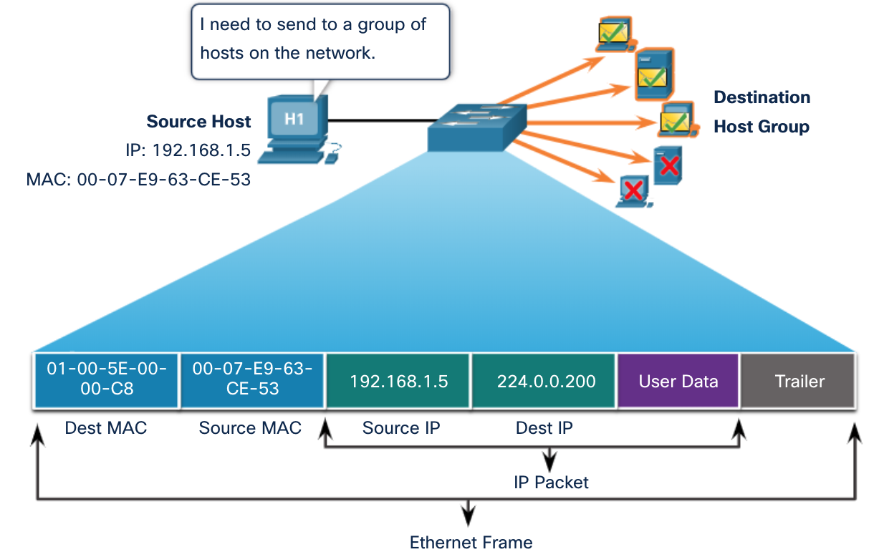
Ethernet MAC Addresses Multicast MAC Address
An Ethernet multicast frame is received and processed by a group of devices that belong to the same multicast group.
There is a destination MAC address of 01-00-5E when the encapsulated data is an IPv4 multicast packet and a destination MAC address of 33-33 when the encapsulated data is an IPv6 multicast packet.
There are other reserved multicast destination MAC addresses for when the encapsulated data is not IP, such as Spanning Tree Protocol (STP).
It is flooded out all Ethernet switch ports except the incoming port, unless the switch is configured for multicast snooping. It is not forwarded by a router, unless the router is configured to route multicast packets.
Because multicast addresses represent a group of addresses (sometimes called a host group), they can only be used as the destination of a packet. The source will always be a unicast address.
As with the unicast and broadcast addresses, the multicast IP address requires a corresponding multicast MAC address.
Notes:
7 – Ethernet Switching
7.2 – Ethernet MAC Address
7.2.6 - Multicast MAC Address

Slide 35
7.3 The MAC Address Table
Notes:
7 -Ethernet Switching
7.3 - The MAC Address Table

Slide 36
The MAC Address Table Switch Fundamentals
A Layer 2 Ethernet switch uses Layer 2 MAC addresses to make forwarding decisions. It is completely unaware of the data (protocol) being carried in the data portion of the frame, such as an IPv4 packet, an ARP message, or an IPv6 ND packet. The switch makes its forwarding decisions based solely on the Layer 2 Ethernet MAC addresses.
An Ethernet switch examines its MAC address table to make a forwarding decision for each frame, unlike legacy Ethernet hubs that repeat bits out all ports except the incoming port.
When a switch is turned on, the MAC address table is empty
Note: The MAC address table is sometimes referred to as a content addressable memory (CAM) table.
Notes:
7 – Ethernet Switching
7.3 – The MAC Address Table
7.3.1 - Switch Fundamentals

Slide 37
The MAC Address Table Switch Learning and Forwarding
Examine the Source MAC Address (Learn)
Every frame that enters a switch is checked for new information to learn. It does this by examining the source MAC address of the frame and the port number where the frame entered the switch. If the source MAC address does not exist, it is added to the table along with the incoming port number. If the source MAC address does exist, the switch updates the refresh timer for that entry. By default, most Ethernet switches keep an entry in the table for 5 minutes.
Note: If the source MAC address does exist in the table but on a different port, the switch treats this as a new entry. The entry is replaced using the same MAC address but with the more current port number.
Notes:
7 – Ethernet Switching
7.3 – The MAC Address Table
7.3.2 - Switch Learning and Forwarding

Slide 38
The MAC Address Table Switch Learning and Forwarding (Contd.)
Find the Destination MAC Address (Forward)
If the destination MAC address is a unicast address, the switch will look for a match between the destination MAC address of the frame and an entry in its MAC address table. If the destination MAC address is in the table, it will forward the frame out the specified port. If the destination MAC address is not in the table, the switch will forward the frame out all ports except the incoming port. This is called an unknown unicast.
Note: If the destination MAC address is a broadcast or a multicast, the frame is also flooded out all ports except the incoming port.
Notes:
7 – Ethernet Switching
7.3 – The MAC Address Table
7.3.2 - Switch Learning and Forwarding

Slide 39
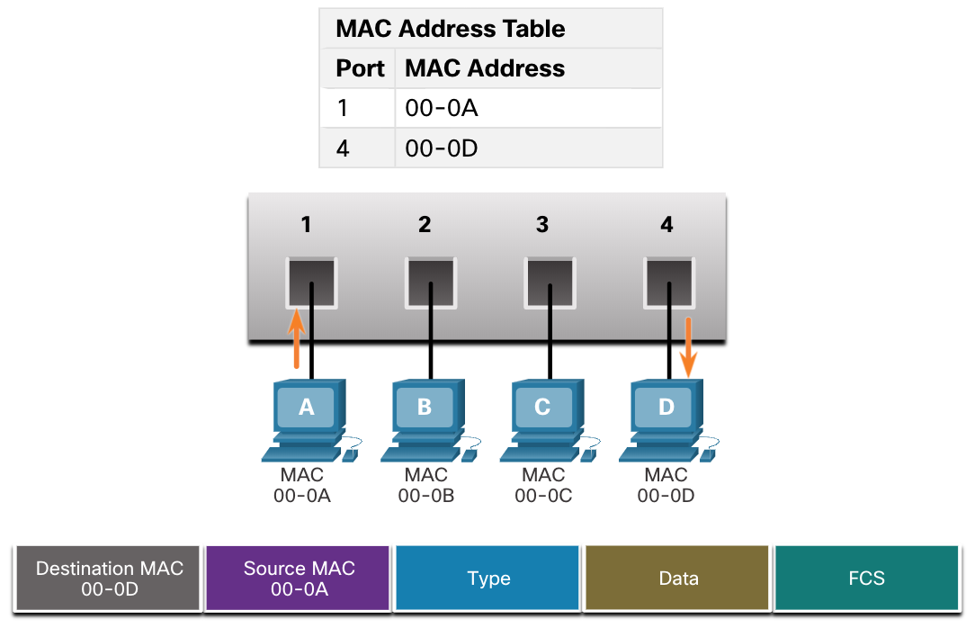
The MAC Address Table Filtering Frames
As a switch receives frames from different devices, it is able to populate its MAC address table by examining the source MAC address of every frame. When the MAC address table of the switch contains the destination MAC address, it is able to filter the frame and forward out a single port.
Notes:
7 – Ethernet Switching
7.3 – The MAC Address Table
7.3.3 - Filtering Frames

Slide 40
7.4 Switch Speeds and Forwarding Methods
Notes:
7 - Ethernet Switching
7.4 - Switch Speeds and Forwarding Methods

Slide 41
Switch Speeds and Forwarding Methods Frame Forwarding Methods on Cisco Switches
Switches use one of the following forwarding methods for switching data between network ports:
Store-and-forward switching - This frame forwarding method receives the entire frame and computes the CRC. If the CRC is valid, the switch looks up the destination address, which determines the outgoing interface. Then the frame is forwarded out of the correct port.
Cut-through switching - This frame forwarding method forwards the frame before it is entirely received. At a minimum, the destination address of the frame must be read before the frame can be forwarded.
A big advantage of store-and-forward switching is that it determines if a frame has errors before propagating the frame. When an error is detected in a frame, the switch discards the frame. Discarding frames with errors reduces the amount of bandwidth consumed by corrupt data.
Store-and-forward switching is required for quality of service (QoS) analysis on converged networks where frame classification for traffic prioritization is necessary. For example, voice over IP (VoIP) data streams need to have priority over web-browsing traffic.
Notes:
7 – Ethernet Switching
7.4 – Switch Speeds and Forwarding Methods
7.4.1 – Frame Forwarding Methods on Cisco Switches

Slide 42
Switch Speeds and Forwarding Methods Cut-Through Switching
In cut-through switching, the switch acts upon the data as soon as it is received, even if the transmission is not complete. The switch buffers just enough of the frame to read the destination MAC address so that it can determine to which port it should forward out the data. The switch does not perform any error checking on the frame.
There are two variants of cut-through switching:
Fast-forward switching - Offers the lowest level of latency by immediately forwarding a packet after reading the destination address. Because fast-forward switching starts forwarding before the entire packet has been received, there may be times when packets are relayed with errors. The destination NIC discards the faulty packet upon receipt. Fast-forward switching is the typical cut-through method of switching.
Fragment-free switching - A compromise between the high latency and high integrity of store-and-forward switching and the low latency and reduced integrity of fast-forward switching, the switch stores and performs an error check on the first 64 bytes of the frame before forwarding. Because most network errors and collisions occur during the first 64 bytes, this ensures that a collision has not occurred before forwarding the frame.
Notes:
7 – Ethernet Switching
7.4 – Switch Speeds and Forwarding Methods
7.4.2 – Cut-Through Switching

Slide 43
Switch Speeds and Forwarding Methods Memory Buffering on Switches
An Ethernet switch may use a buffering technique to store frames before forwarding them or when the destination port is busy because of congestion.
Shared memory buffering also results in larger frames that can be transmitted with fewer dropped frames. This is important with asymmetric switching which allows for different data rates on different ports. Therefore, more bandwidth can be dedicated to certain ports (e.g., server port).
Method | Description
Port-based memory | Frames are stored in queues that are linked to specific incoming and outgoing ports. A frame is transmitted to the outgoing port only when all the frames ahead in the queue have been successfully transmitted. It is possible for a single frame to delay the transmission of all the frames in memory because of a busy destination port. This delay occurs even if the other frames could be transmitted to open destination ports.
Shared memory | Deposits all frames into a common memory buffer shared by all switch ports and the amount of buffer memory required by a port is dynamically allocated. The frames in the buffer are dynamically linked to the destination port enabling a packet to be received on one port and then transmitted on another port, without moving it to a different queue.
Notes:
7 – Ethernet Switching
7.4 – Switch Speeds and Forwarding Methods
7.4.3 – Memory Buffering on Switches

Slide 44
Switch Speeds and Forwarding Methods Duplex and Speed Settings
Two of the most basic settings on a switch are the bandwidth (“speed”) and duplex settings for each individual switch port. It is critical that the duplex and bandwidth settings match between the switch port and the connected devices.
There are two types of duplex settings used for communications on an Ethernet network:
Full-duplex - Both ends of the connection can send and receive simultaneously.
Half-duplex - Only one end of the connection can send at a time.
Autonegotiation is an optional function found on most Ethernet switches and NICs. It enables two devices to automatically negotiate the best speed and duplex capabilities.
Note: Gigabit Ethernet ports only operate in full-duplex.
Notes:
7 – Ethernet Switching
7.4 – Switch Speeds and Forwarding Methods
7.4.4 – Duplex and Speed Settings

Slide 45
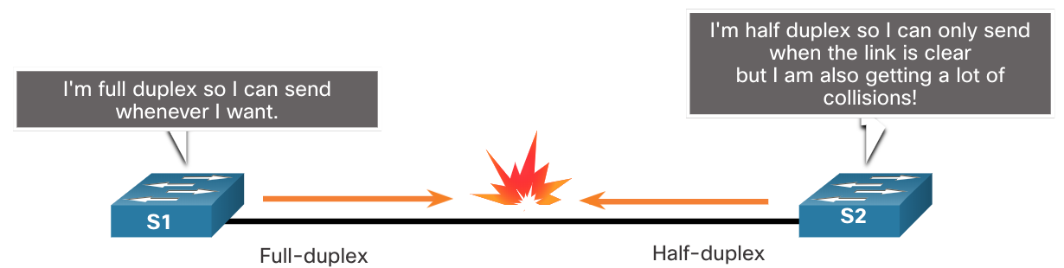
Switch Speeds and Forwarding Methods Duplex and Speed Settings
Duplex mismatch is one of the most common causes of performance issues on 10/100 Mbps Ethernet links. It occurs when one port on the link operates at half-duplex while the other port operates at full-duplex.
This can occur when one or both ports on a link are reset, and the autonegotiation process does not result in both link partners having the same configuration.
It also can occur when users reconfigure one side of a link and forget to reconfigure the other. Both sides of a link should have autonegotiation on, or both sides should have it off. Best practice is to configure both Ethernet switch ports as full-duplex.
Notes:
7 – Ethernet Switching
7.4 – Switch Speeds and Forwarding Methods
7.4.4 – Duplex and Speed Settings

Slide 46
Switch Speeds and Forwarding Methods Auto-MDIX
Connections between devices once required the use of either a crossover or straight-through cable. The type of cable required depended on the type of interconnecting devices.
Note: A direct connection between a router and a host requires a cross-over connection.
Most switch devices now support the automatic medium-dependent interface crossover (auto-MDIX) feature. When enabled, the switch automatically detects the type of cable attached to the port and configures the interfaces accordingly.
The auto-MDIX feature is enabled by default on switches running Cisco IOS Release 12.2(18)SE or later. However, the feature could be disabled. For this reason, you should always use the correct cable type and not rely on the auto-MDIX feature.
Auto-MDIX can be re-enabled using the mdix auto interface configuration command.
Notes:
7 – Ethernet Switching
7.4 – Switch Speeds and Forwarding Methods
7.4.5 – Auto-MDIX
7.4.6 – Check Your Understanding – Switch Speeds and Forwarding Methods

